Slide 1







Welcome!

Slide 2



Welcome!

Slide 3



Engaging Sustainability in the Community

Slide 4

Competency Development within the
Master of Sustainability,
Chatham University, Pittsburgh
Client-based project with Pittsburgh Center of Creative Reuse (PCCR)
Presented by Joshua Lewis and Jenny Wittann
November 12th, 2014, Penn State University

Slide 5

Project Overview
Background:
PCCR is a non-profit, which “promotes resource conservation, creativity, and community engagement through material reuse.”
→ Project goal: increase bulk manufacturing donations, but presently
PCCR lacks the space and manpower.
Deliverables:
  - Assessment of PCCR’s existing warehouse space and donation processing.
  - Analysis of current inventory management and financial data.
  - Recommend process improvements based on the assessment and Best Practices.
Presented by Joshua Lewis and Jenny Wittann
November 12th, 2014, Penn State University

Slide 6
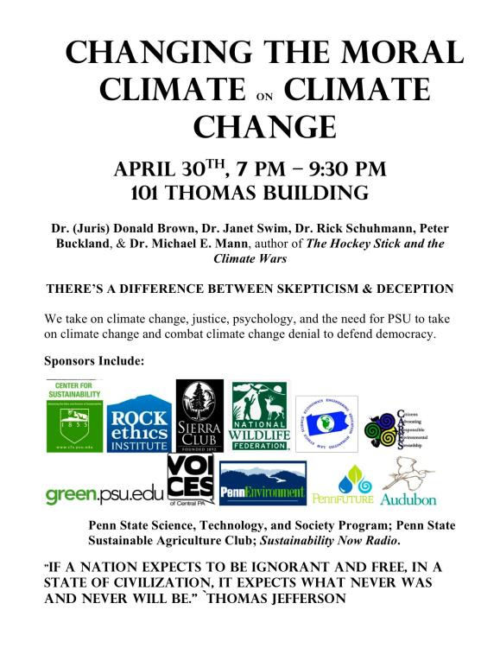
Engaging the broader community on climate change & education
Peter Buckland
Graduate Assistant,
Penn State Sustainability Institute

Slide 7
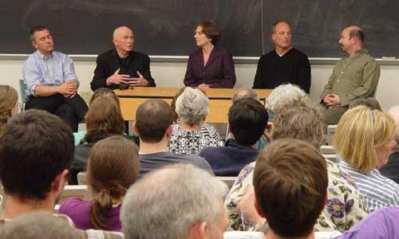
University – Community
Goal: To raise awareness of the danger to democracy by climate change denial.
Means: By connecting
Ethics
Educational missions of universities
Psychology
Other institutional responses
The science of climate change
Outcomes:
- Press
Further activism in community & institution
Sustainability Strategic Plan
Emissions commitments

Slide 8

Home Energy Efficiency and the NELC*
Anthony Magliozzi
* National Energy Leadership Corps

Slide 9
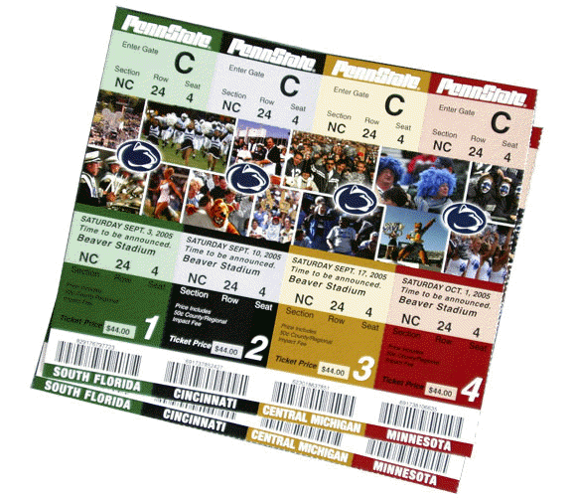


What could you spend the savings on?
Let’s estimate 25% savings using 2012 numbers:
  $107.28 * 0.25 = $26.82/month
  $26.82 * 12 months = $321.84/year
1288 gumballs!!!

Slide 10

Top Five Suggestions made to Homeowners:
Adding insulating to pipes and attic*
Sealing windows and doors*
Energy efficient appliances*
Replacing an old, inefficient furnace or heating/cooling system
Replacing thermostats with programmable models
*Do it yourself projects

Slide 11

Three Campuses, Three Solutions

Slide 12
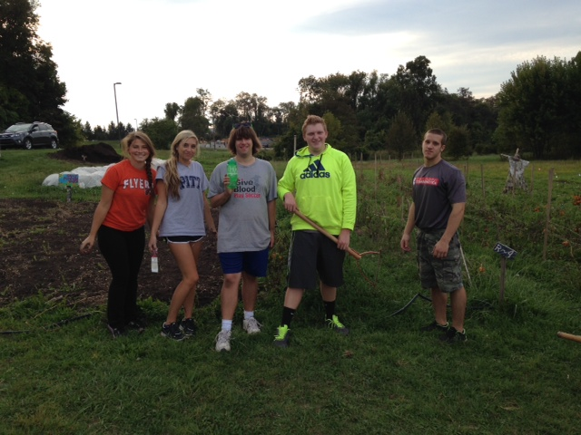
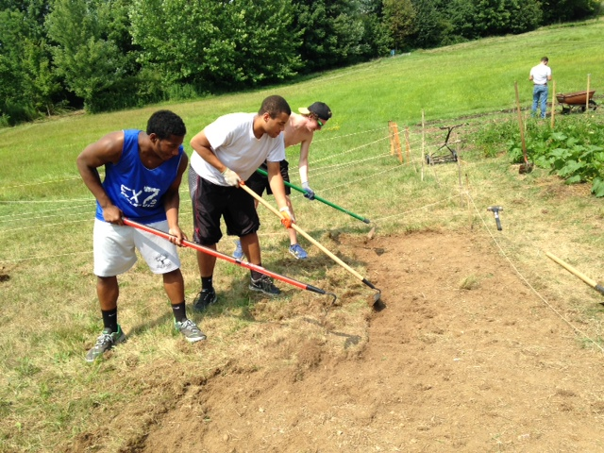
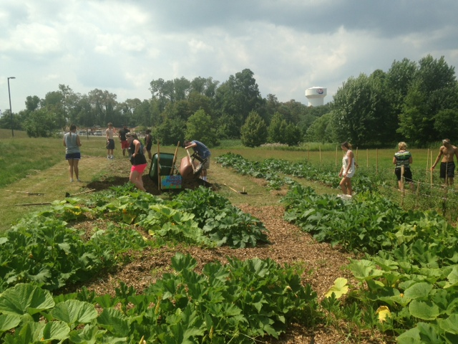
Engaging our Campus
Biology
Geography/Earth Science
Social Work
Shippensburg University Counseling Center
Living Learning Community

Slide 13
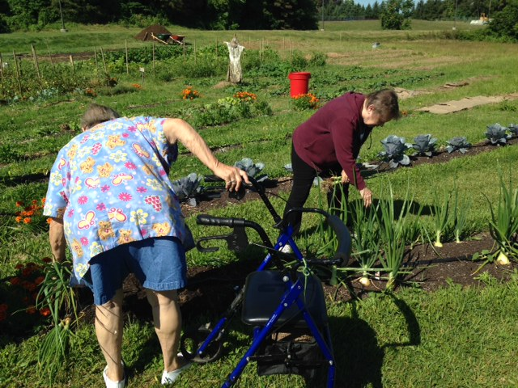
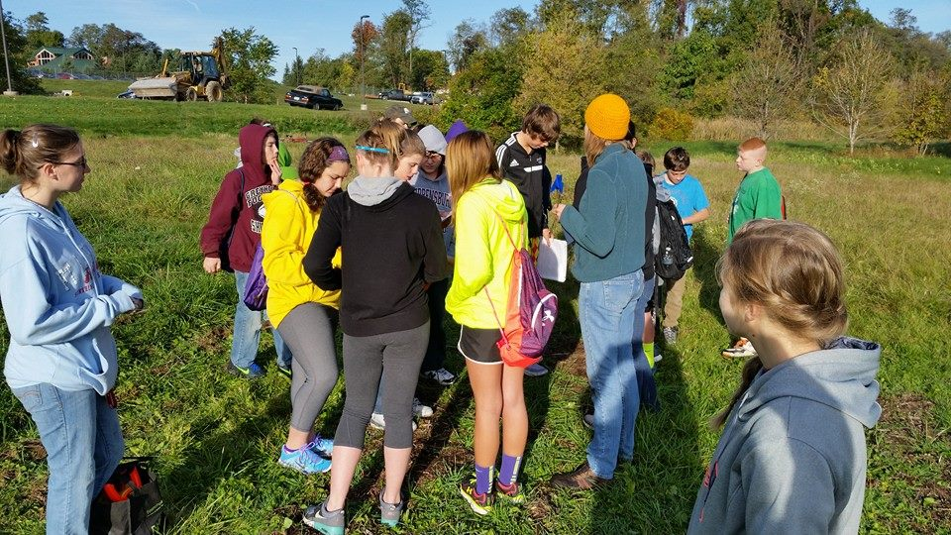
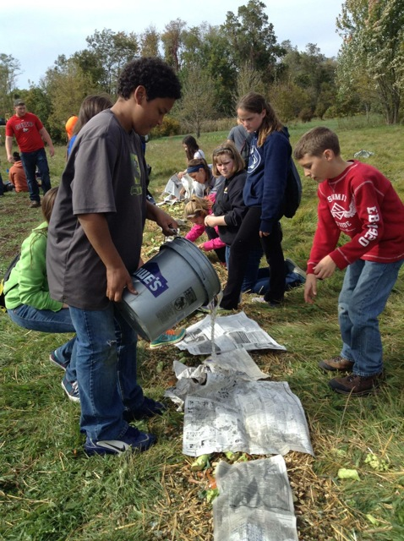
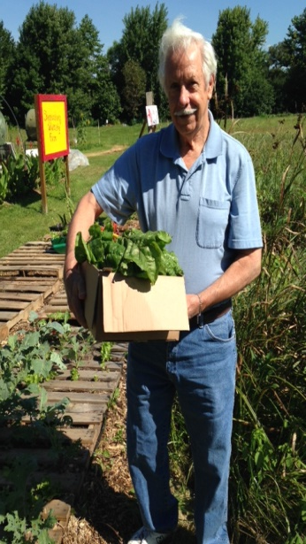
Engaging our
Community
Elementary and middle school volunteers
Girl scout troops
Independent Living Senior Home Volunteer
SPO Volunteers

Slide 14
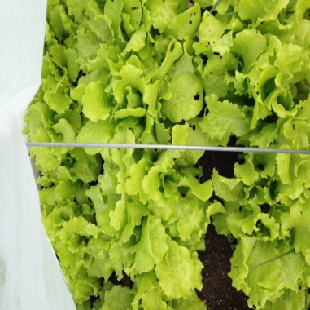
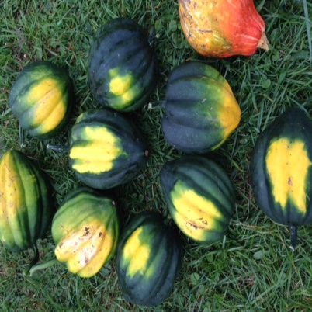
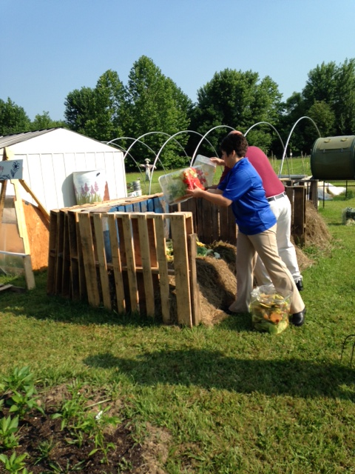
Providing for
Ourselves and Others
We have donated 516 pounds of produce to Shippensburg Produce Outreach
We grew 183 pounds of pumpkins for the Shippensburg Area Middle School after they came on a field trip to plant the seedlings they raised on our farm.
We provided 103 pounds of produce for the Dining Services, most of which has been fresh bunches of swiss chard.
That brings us to 802 total pounds of produce since the middle of May

Slide 15
Off-Site Composting by Third Party
Franklin and Marshall College
Tom Simpson
Sustainability Coordinator

Slide 16
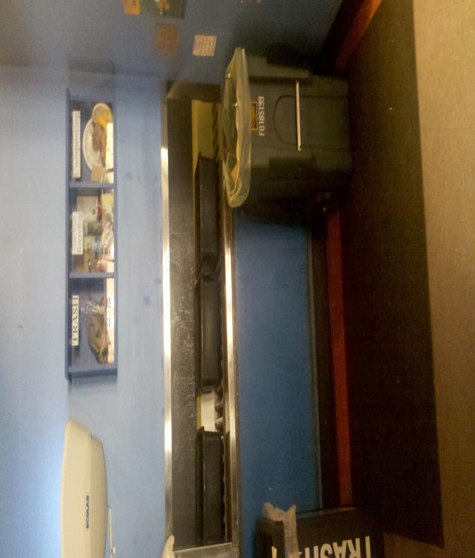
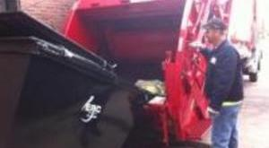
Post-Consumer Collection Point in Dining Hall
Pickup 3x weekly by ERC

Slide 17
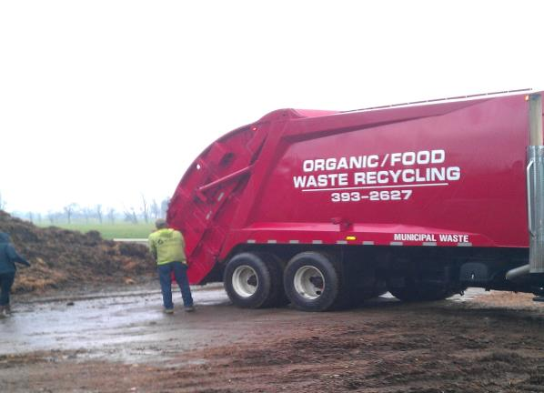
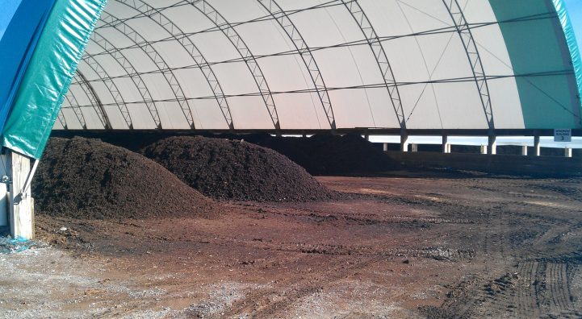
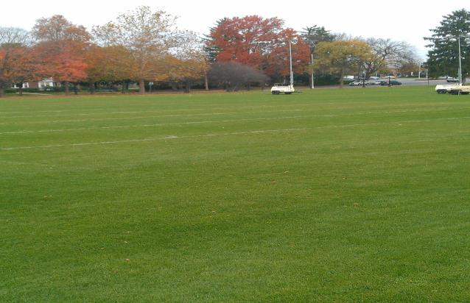
Arrival at Oregon Dairy Organics Compost Site
Composting Tunnel
Practice Field Enriched with Compost

Slide 18

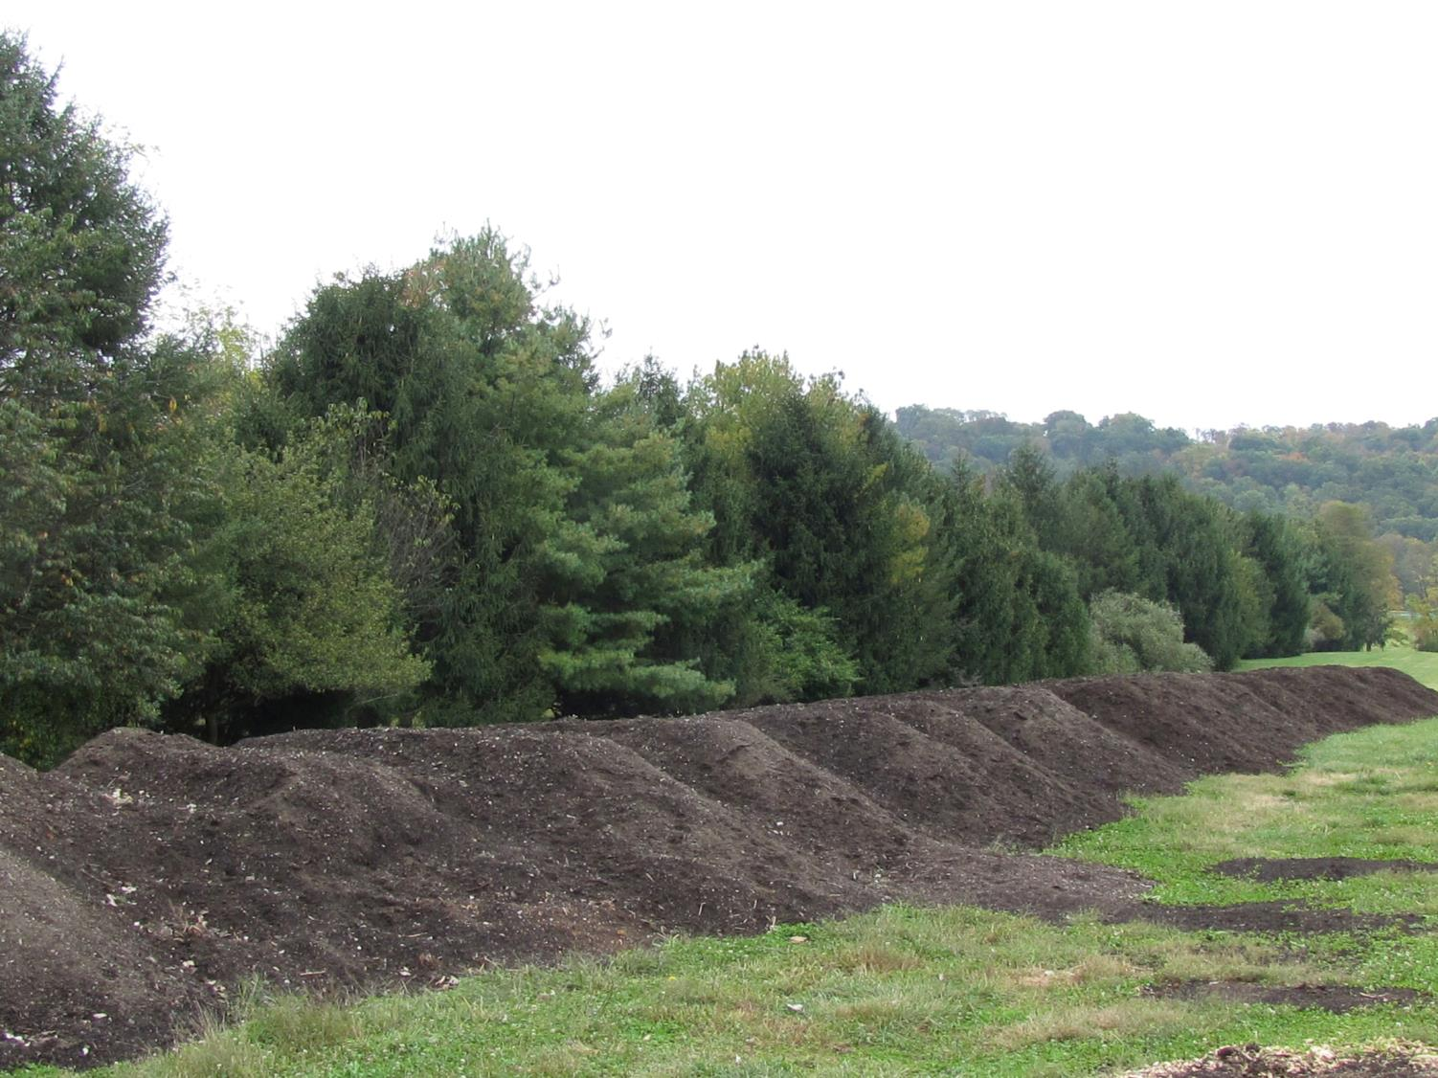




Craig Dalen
Director of Sustainability

Slide 19
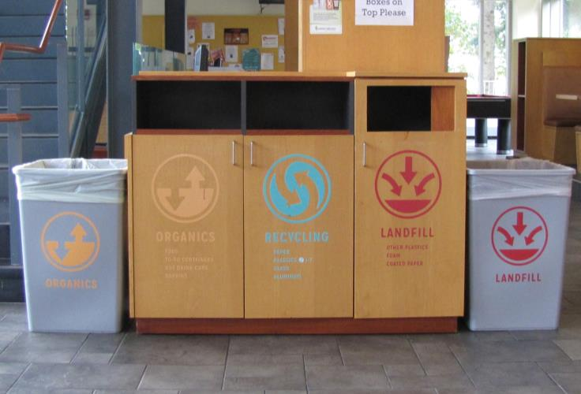
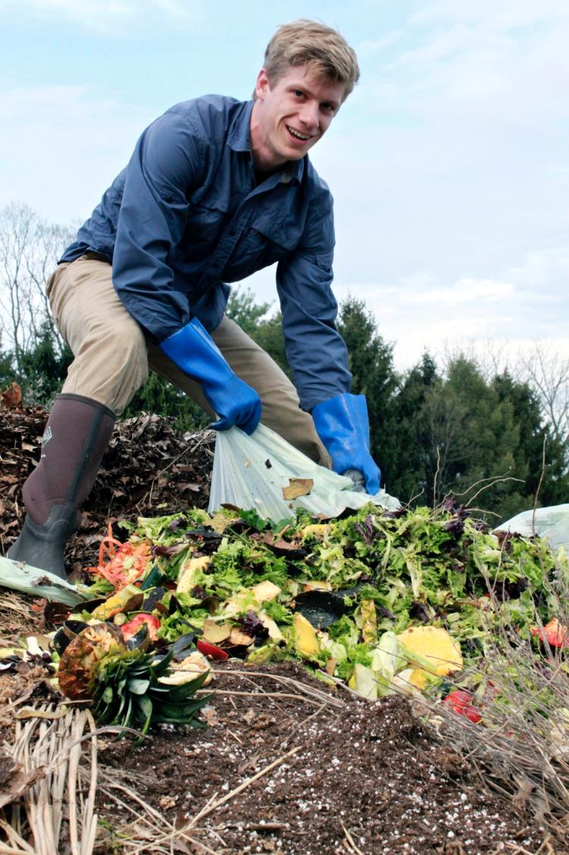
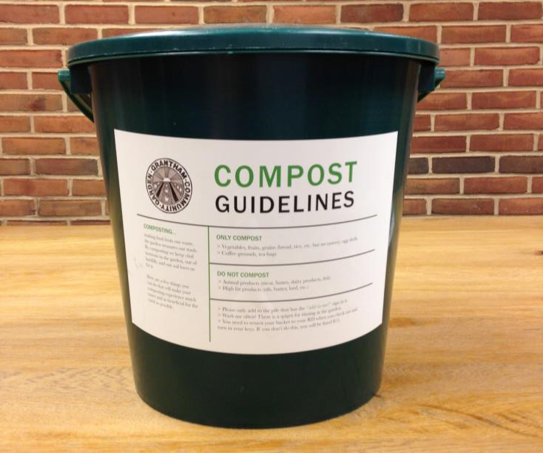


Slide 20
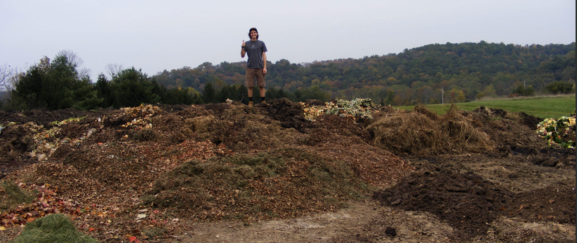
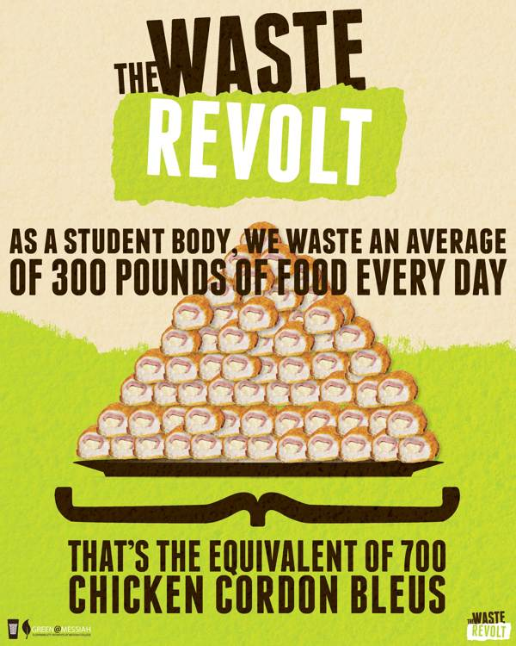

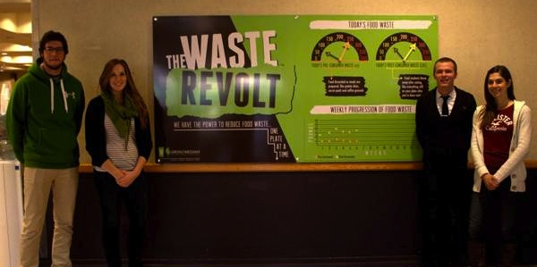

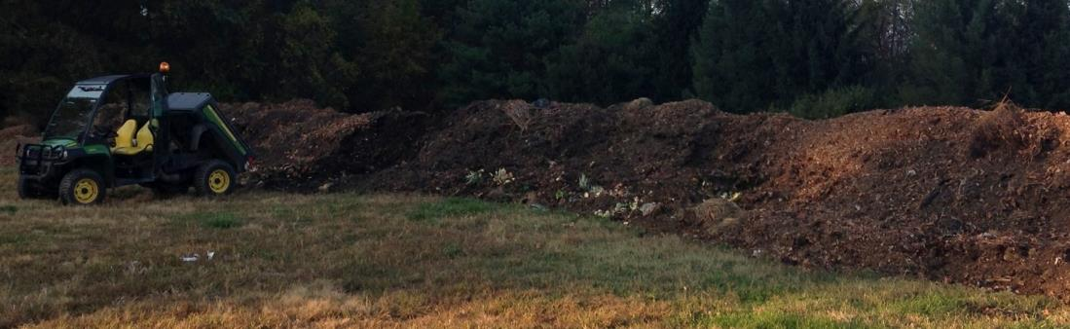

Slide 21


The ORCA at
Keystone College
By: Jennifer Kern

Slide 22
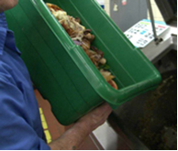
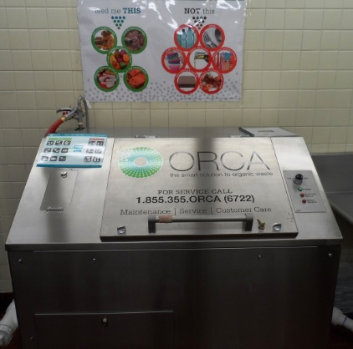
What is an ORCA?
The ORCA is a machine that handles organic food waste in an environmentally friendly way.
Instead of wasting time, energy, and money filling landfills
the ORCA gives back in an “eco-friendly” way.

Slide 23


How does it Work?
Food Waste becomes Water
Food waste is dumped into the machine. Pizza crusts, orange peels, and essentially any food in the Student Restaurant!
The waste is broken down within 24 hours. The waste or “nutrient rich water” is disposed through the waste water system!
Benefits of the ORCA
Reduces waste disposal costs
Reduces CO2 Emissions
Has low operation costs to run
Eliminates food waste!
Reduces methane gas production
The information used in this presentation was originally from ORCA’s website: http://www.totallygreen.com/

Slide 24
Keynote: Michael Mann

Slide 25
Lunch/ Poster Session

Slide 26
PERC Business & Elections

Slide 27
Penn State’s Net Impact Chapter

Slide 28
Sponsor Spotlight

Slide 29
Engaging Sustainability on Campus

Slide 30
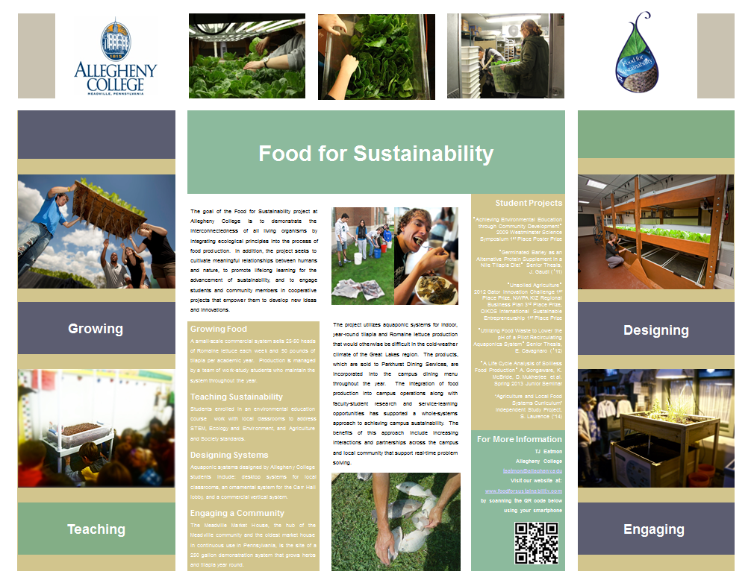

Slide 31
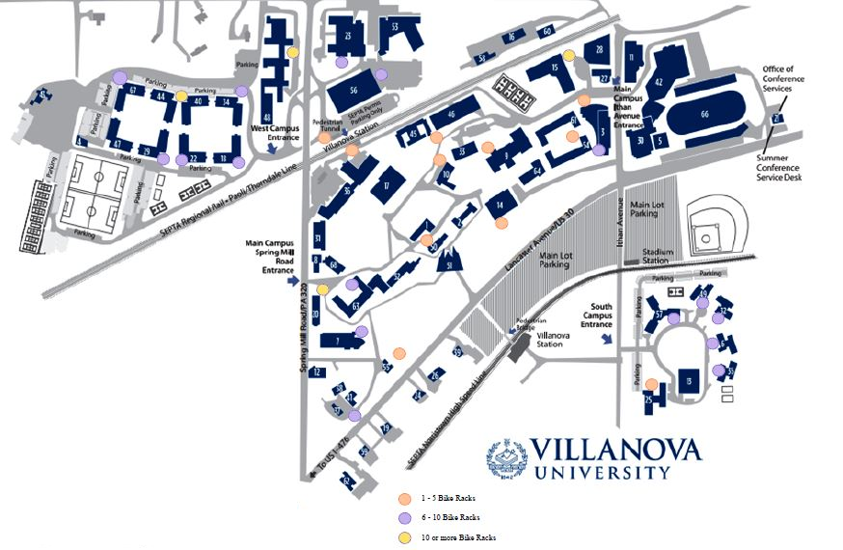

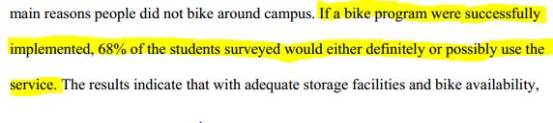

Slide 32

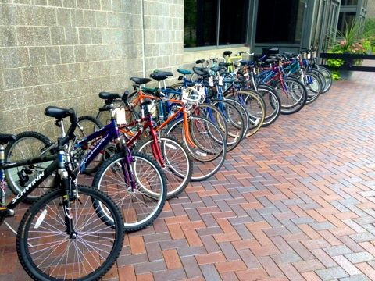

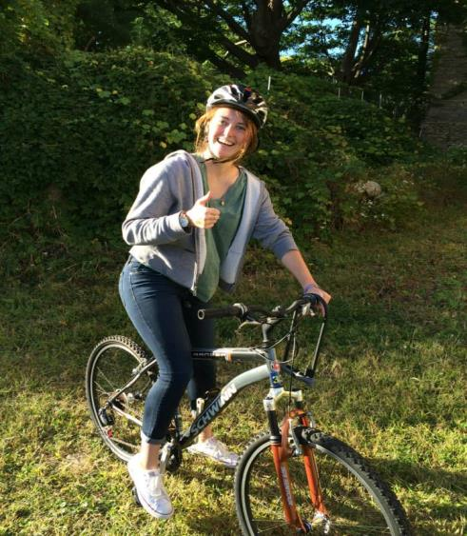

Slide 34


The New Frontier
Embedding Sustainability in Unit Strategic Planning
Erik Foley, Managing Director, Penn State's Sustainability Institute
erik@psu.edu

Slide 35

For the first time, every Penn State college, campus, and support unit had to include sustainability in their strategic planning.
Is strategic planning a leverage point?

Slide 36

Or do plans just collect dust?

Slide 37






Six Steps of Sustainability Planning
Understand Sustainability
Assess Current State
Identify Priorities
Create a Vision
Set Goals and Develop Metrics
Develop an Implementation Plan

Slide 38
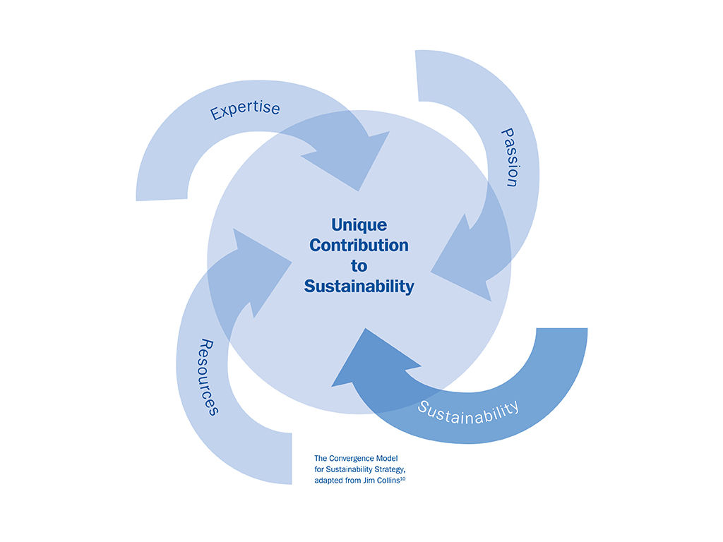

Slide 39
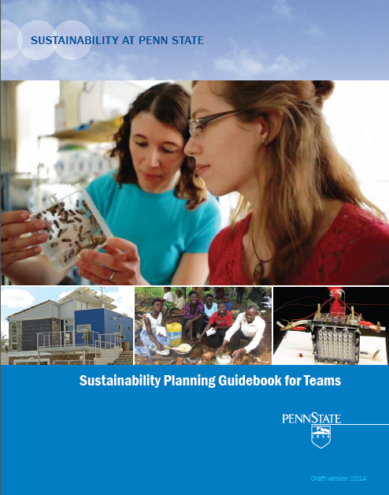
Join a growing community of users and innovators by downloading your copy of Penn State’s Sustainability Planning Guidebook for Teams available at:
http://sustainability.psu.edu/strategic-planning

Slide 40



Sadie Stuart
Allegheny College
Sustainability of Athletic Travel
&
The Carbon Conference

Slide 41
Engaging Sustainability on Campus

Slide 42
Campus Sustainability Champions

Slide 43

2014
Campus
Sustainability Champions
Student CSCs
Josh & Zach Berliner
Bucknell University
Briana Kewson
Franklin and Marshall
Stephanie Bradley
Millersville University
Mariah Murphy
Dickinson College
Lynette Dooley
Lycoming College
Susan Washko/
Edible Allegheny
Alleghey College

Slide 44
2014 Campus
Sustainability Champions
Non-Student CSCs
Liesel Schwarz
Villanova University
John Anderson
Millersville University
Helen Takacs
Dickinson College
Nic Auwaerter
Franklin and Marshall
Christopher Uhl
Penn State University
Nick Iula
Shippensburg University
Caryl Waggett
Allegheny College

Slide 45

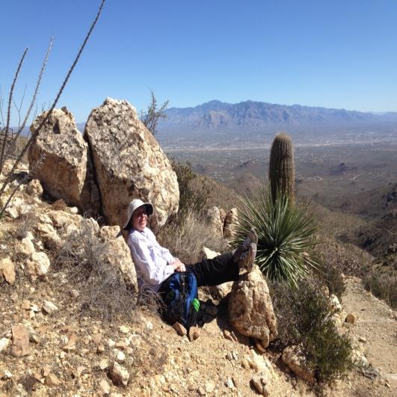
Helen Takacs
Associate Professor
Internat’l Bus. & Mgmt.
My work is inspired and informed by the management scholar Sumantra Ghoshal: “Business as a Force for Good”
  My research focuses on corporate social responsibility and business sustainability
  My general business courses routinely integrate environmental sustainability issues, such as climate change
  My electives deal specifically with environmental sustainability
  At our college, I am leading the effort to develop a curriculum on social and environmental entrepreneurship
  I hope my students will be empowered to make positive change in our world

Slide 46

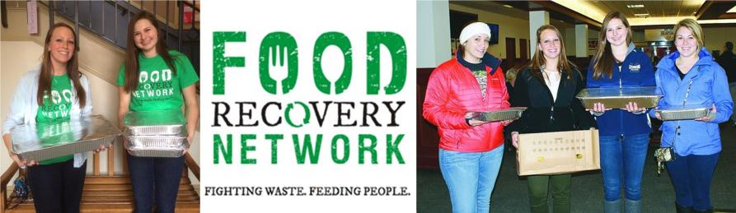


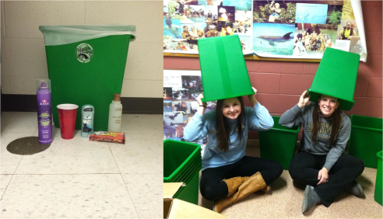


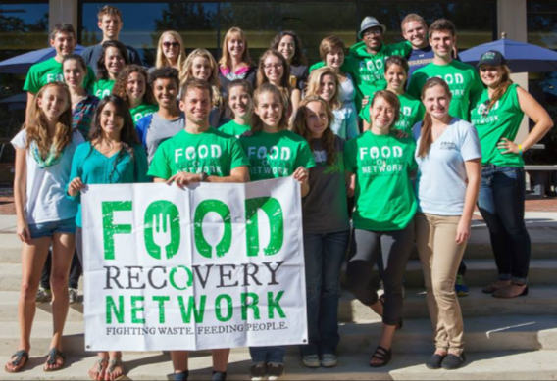
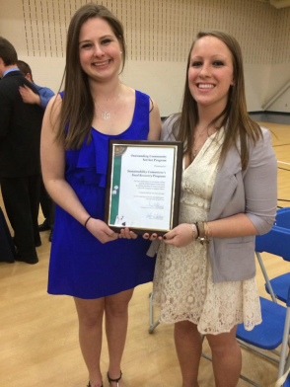
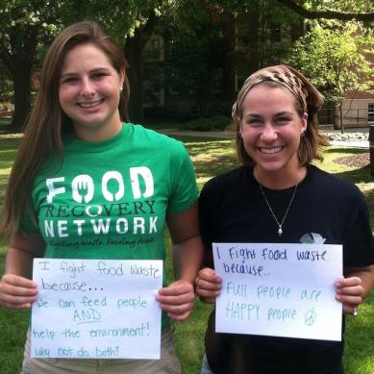
Lycoming College Sustainability Committee

Slide 47
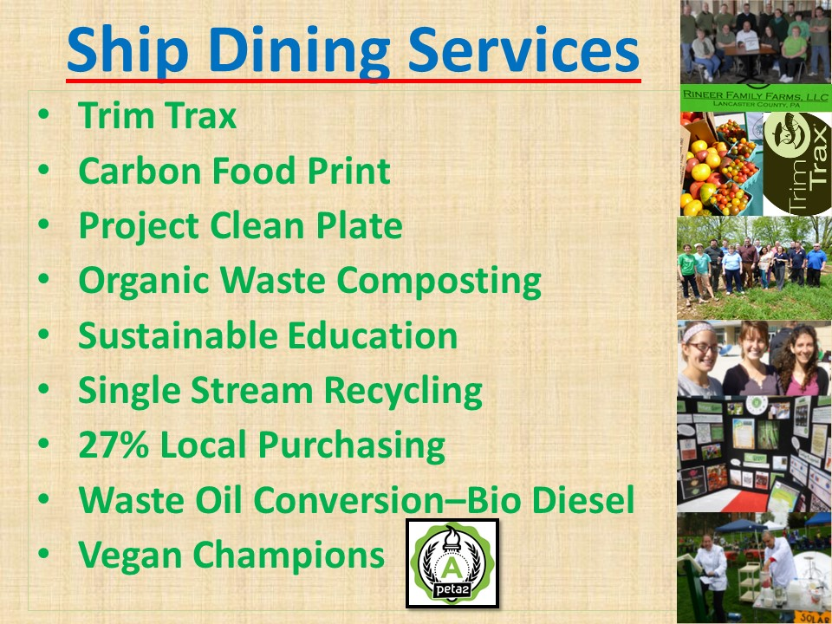

Slide 48
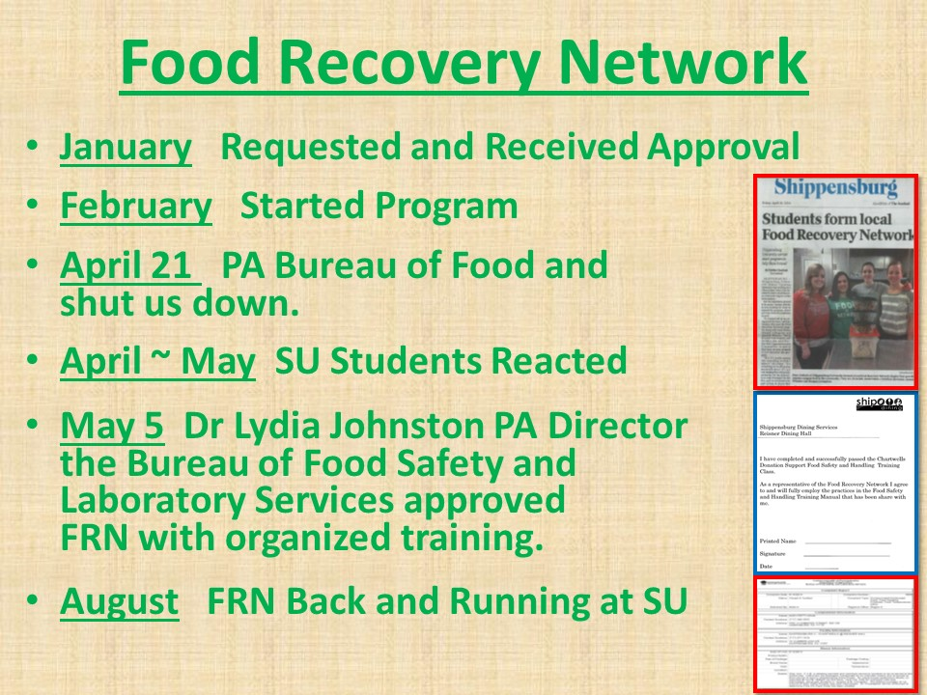

Slide 49
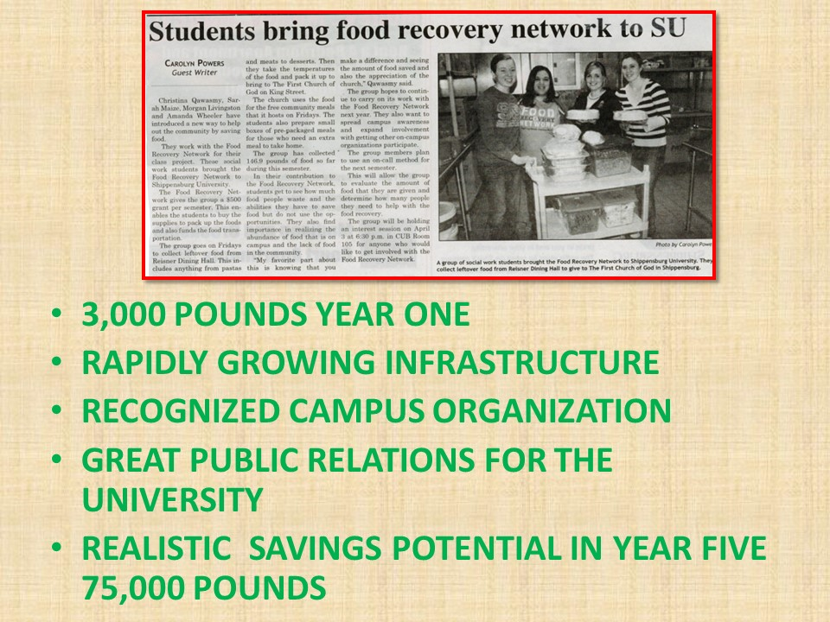

Slide 50






Comprehensive Assessment of Bucknell’s Recycling System
Josh & Zach Berliner
PERC Fall Conference
November 2014

Slide 51
Proposed Renovations Project
16 buildings
Will save 5,622,176 gallons of water per year
  7% reduction in total water consumed by the university
  50% reduction in total water consumption in the 16 buildings combined
Will save the university $89,800.40 per year
  10% reduction in the university’s total water bill per year
  60% reduction in the total water bill of all 16 buildings combined
Josh & Zach Berliner
PERC Fall Conference
November 2014

Slide 52
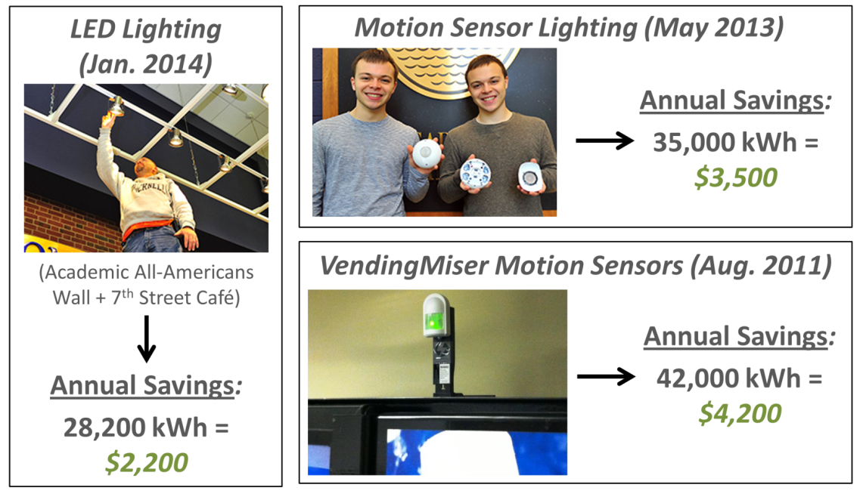
Bucknell Green Fund
Josh & Zach Berliner
PERC Fall Conference
November 2014

Slide 53
Villanova’s Commitment to Sustainability
Liesel Schwarz

Slide 54
Communications
New Website (www.Villanova.edu/Sustainability)
Monthly Newsletter
Annual Report
Social Media
  Facebook (345 likes)
  Twitter (40 Followers)
  Instagram (189 Followers)

Slide 55



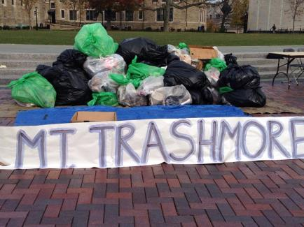

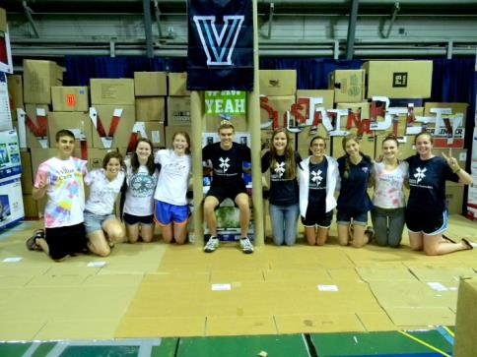
Student Programs
Presidents Environmental Sustainability Student Working Group
  Nova Bike Share
  TradePal
  Kill the Cup
  Orientation
  Campus Sustainability Day
  Earth Day of Service and BBQ
Athletic EcoReps
  Locker room Recycling Bin
  ShoeBox Recycling
  Zero Waste Game (TBA)

Slide 56
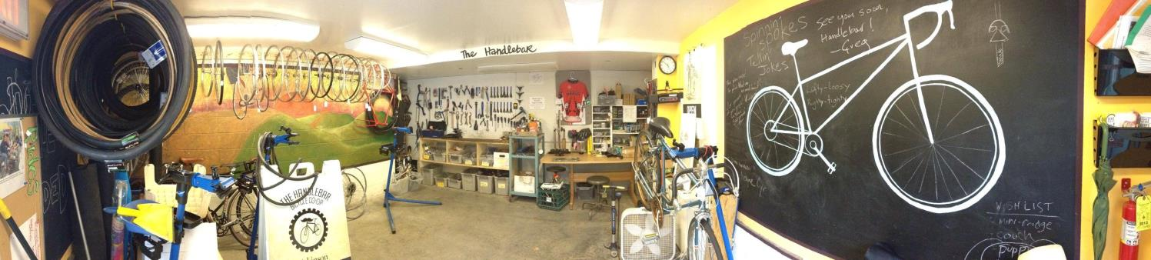
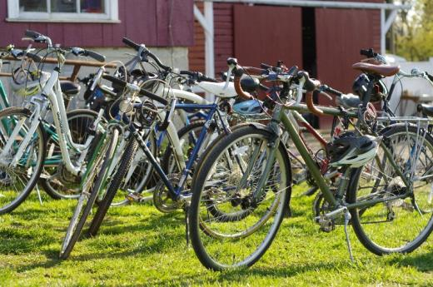


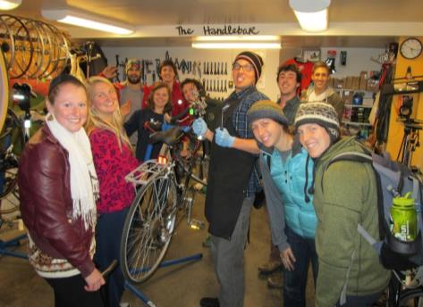




Biking@Dickinson

Slide 57
Campus Sustainability Champions

Slide 58

Go Forth!

